Slide 1
Grooper 2.8 Feature Overview
In this discussion we’ll take a look at and discuss features in the upcoming 2.8 release of Grooper.

Slide 2
What’s new in 2.8
Upcoming Features and Functionality
New Recognize activity
Improvements to data integration capabilities, including:
Expression-based field mapping on export
Expanded database lookup abilities
New PDF Generation abilities
Improvements to extraction capabilities, including
New field extraction methods
Improved OMR
New and improved Visual Studio Integration
End-to-End Microform Processing
New IP commands:
Shade Removal
Shape Removal
Scratch Removal
Extract Page
Improved Diagnostic Generation

Slide 3
Why it matters
What these features do for you
Streamlined Grooper processes
More configurable and robust connections to data and content systems
Faster, easier Grooper architecting
More extensible than ever before
Supports a new family of physical formats

Slide 4
New Features: Extraction and integration

Slide 5
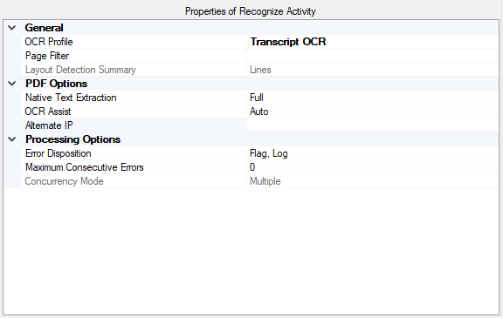
Recognize
Recognize is a new activity that replaces both OCR and PDF Text Extract.
Recognize Functionality
Perform OCR on a page or on images embedded in a pdf
Extract only native PDF Text
Extract only layout data (lines, OMR box, barcode locations – these frequently contain a lot of information)
Perform any combination of the above at either the document or the page level

Slide 6
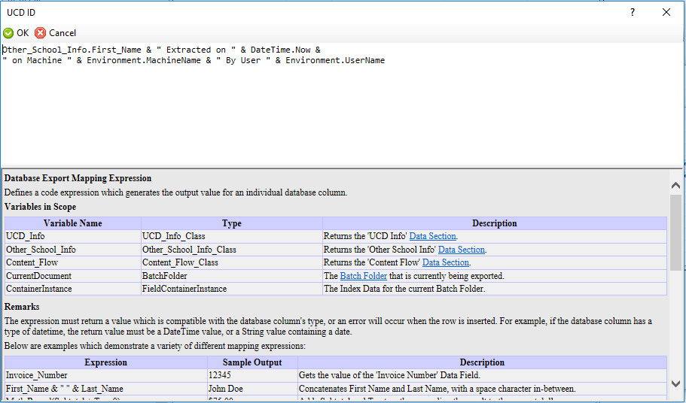
Expression-Based Field Mapping
Fields may now be mapped on export using expressions similar to calculate and validate expressions.
Expressions are optional and appear as a configurable property on direct mapping objects.
For CMIS sources, these must be configured on the CMIS connection’s content types

Slide 7
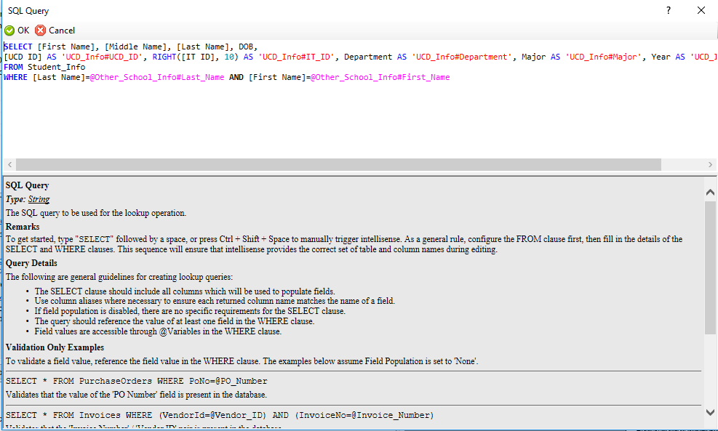
Improved Database Lookup
Lookups are now defined at the data model or data section level. They may now reference any number of DB columns and Grooper fields.
Lookups can now:
Provide configurable UI dialogue when multiple matches are returned
May be configured against a single- or multi-column lexicon
Have configurable trigger modes, miss and conflict dispositions, and can be configured to not populate, supplement, or overwrite Grooper fields.

Slide 8
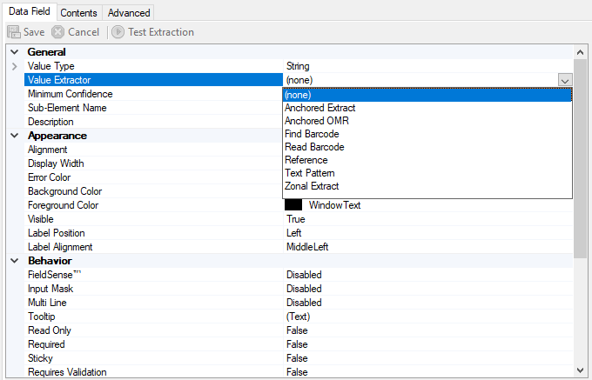
New Field Extraction methods
In addition to the already-existing reference and text pattern, data fields have been updated with new extraction methods.
Anchored extract (specify a rectangle relative to a text anchor)
Anchored OMR (run OMR on a box relative to a text anchor)
Find Barcode (searches layout data for a barcode – must have stored layout data!)
Read barcode (executes barcode read on document, with or without layout data)
Zonal extract (extracts data within a defined zone)

Slide 9
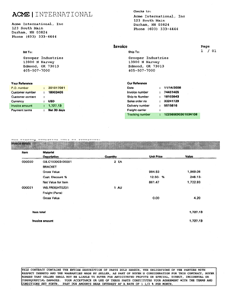
New PDF Generation
Grooper’s PDF generation can now add native-PDF elements to generated PDFs.
The elements that can be added include:
Highlighting
Signature widgets
Checkbox widgets
Textbox widgets
Radio group widgets

Slide 10
New Features: Development

Slide 11
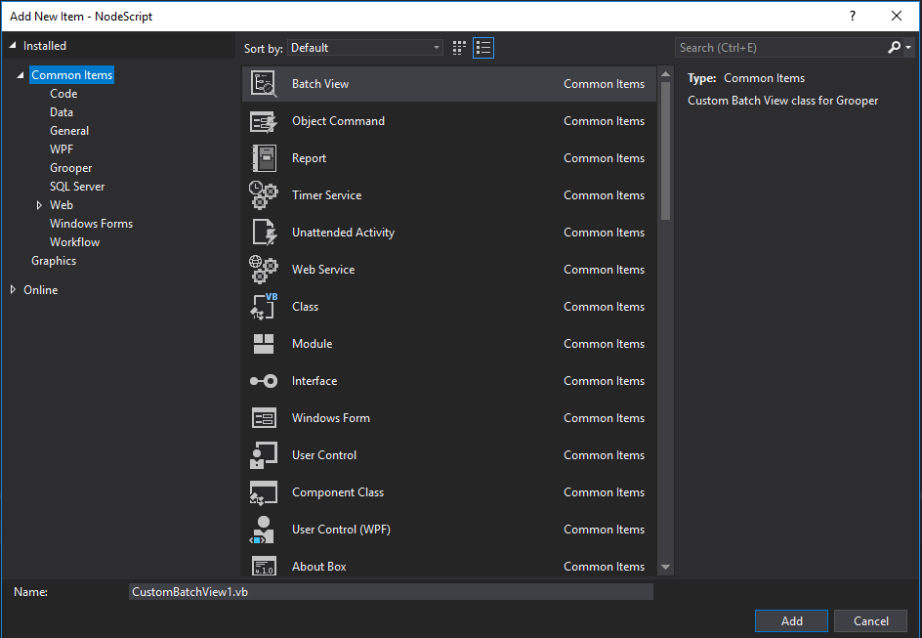
Improved Visual Studio Integration
Visual studio integration has been completely redone
VSTA is no longer needed
Integration works with any version of Visual Studio from 2012 on
C# is now supported
VSI also includes templates for common custom objects and activities.
New scripting tutorials on Grooper xChange

Slide 12
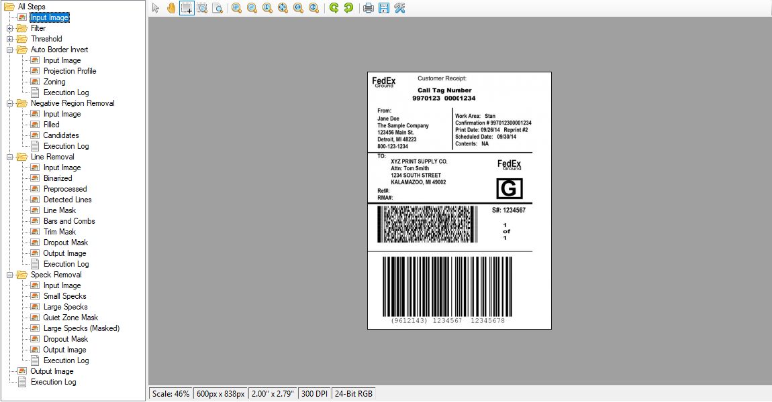
Improved Diagnostic Generation
Expanded diagnostic information when configuring IP profiles and IP steps.
Easier to see intermediate and diagnostic images, and execution logs
Easier to tune IP to specific applications and document sets.

Slide 13
New Features: Formats and Media

Slide 14
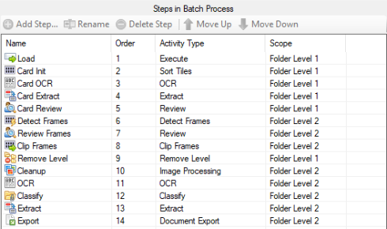
End-to-End microform Processing
Grooper now has the ability to process the output from microform scanners
Processing occurs in a number of steps:
Scanner output is imported
Scanner output is organized into folders by card, for which a preview image is generated
Individual frames on the card are detected, with the option for review an manual correction
Frames are clipped, generating one image per document on the fiche card
Film-specific IP commands (extract image, scratch removal) and other IP commands (stretch contrast) are run, preparing documents for classification, extraction, etc.

Slide 15
New Features: image processing

Slide 16
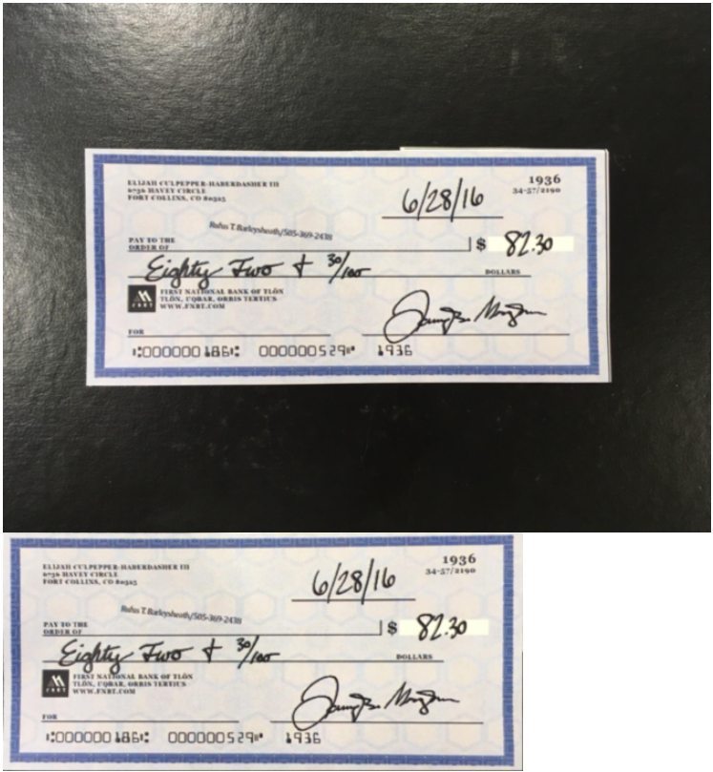
New IP Commands
Grooper 2.8 adds four new image processing commands.
Shade removal (removes halftone images, such as shaded headers, from a document)
Shape removal (similar to shape detection, but with the ability to remove the shape)
Scratch removal (designed to remove scratches on film-based media)
Extract page (extract document from carrier image – like banking apps do with images of checks)

Slide 17
Questions?
Thank you!

